Slide 1
Jax Resilience
Analysis of Taxable Value & Flood Risk
By: Kevin O’Halloran

Slide 2
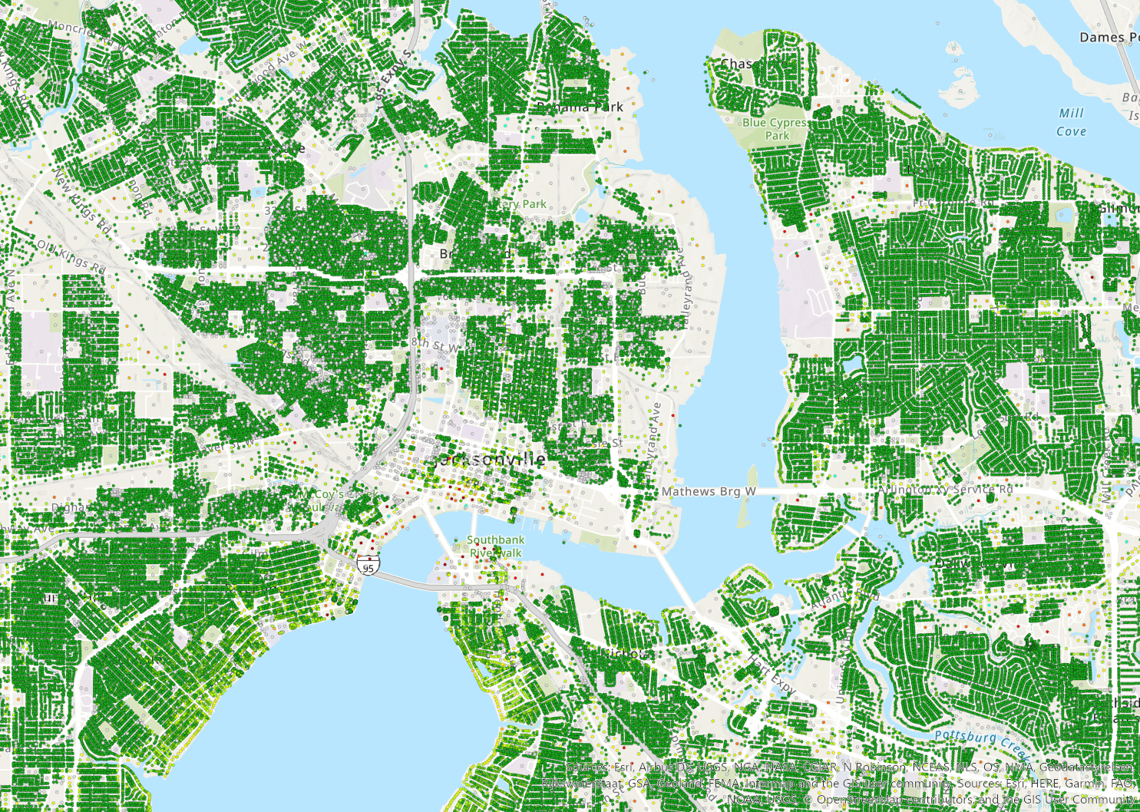
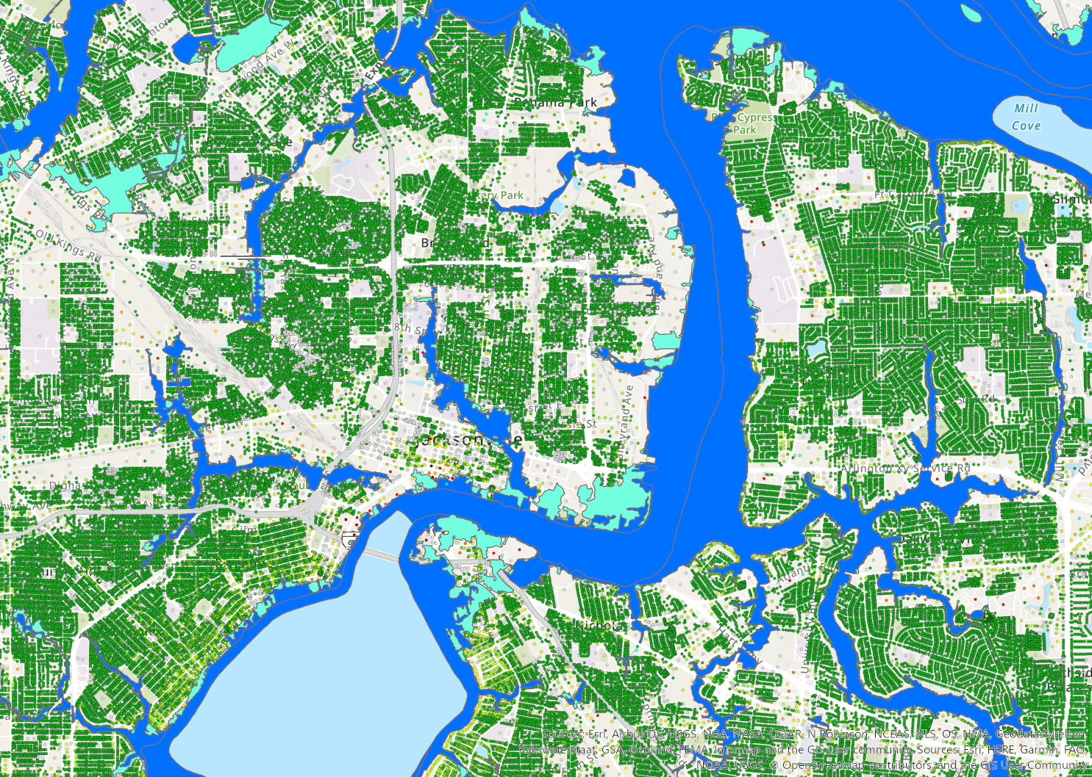
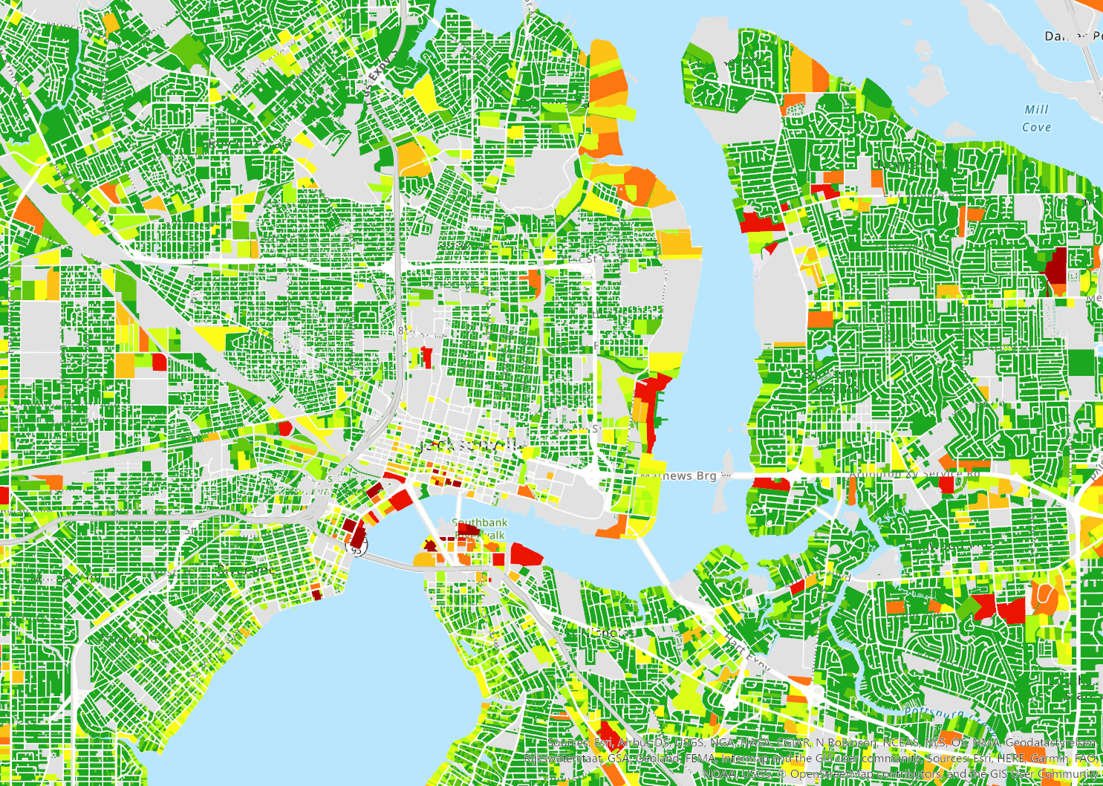
Methodology

Slide 3
Limitations and Advantages to the Methodology
Centroid points only represent the geometric center of each parcel. When flood plains are intersected, parcels with partial flooding are not captured.
FEMA Flood Plains are inexact and only represent coastal and riverine flooding
Does not account for future sea level rise or increasing likelihood of flood events
Utilizes 2019 Property Appraiser data and will need to be updated
Using centroid points prevents counting parcels with only minimal fringe flooding and mainly captures instances of severe flooding more likely to impact taxable value
FEMA maps are readily available, publicly verifiable and covers most areas at highest risk of flooding
This provides a conservative baseline estimate

Slide 4
Number of Duval Parcels at Risk of Flooding
GIS Analysis: FEMA Floodplains
# Parcels at risk: 33,239 (9% of total)
2019 Total Duval Parcels: 372,511
Definition of Risk: FEMA 1% annual or 0.2% annual floodplain intersects with center of parcel

Slide 5
Duval Taxable Value at Risk of Flooding
GIS Analysis: 2013 FEMA Floodplains
# Parcels at risk: 33,239 (9%)
2019 Total Duval Parcels: 372,511
Definition of Risk: FEMA 1% annual or 0.2% annual floodplain intersects with center of parcel
2019 Total Duval Taxable Value: $68.8 Billion
Taxable Value at Risk Sum: $6.92 Billion (10%)
Avg. Taxable Value per Parcel: $208,334

Slide 6
Comparison to other Flood Maps

Slide 7
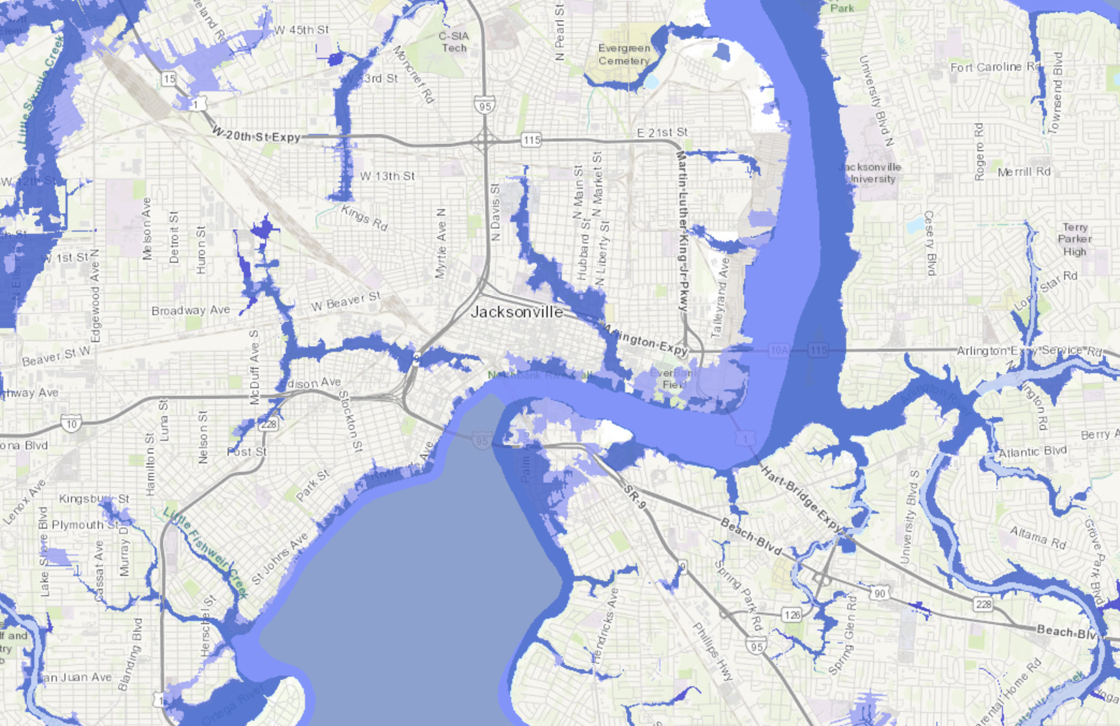
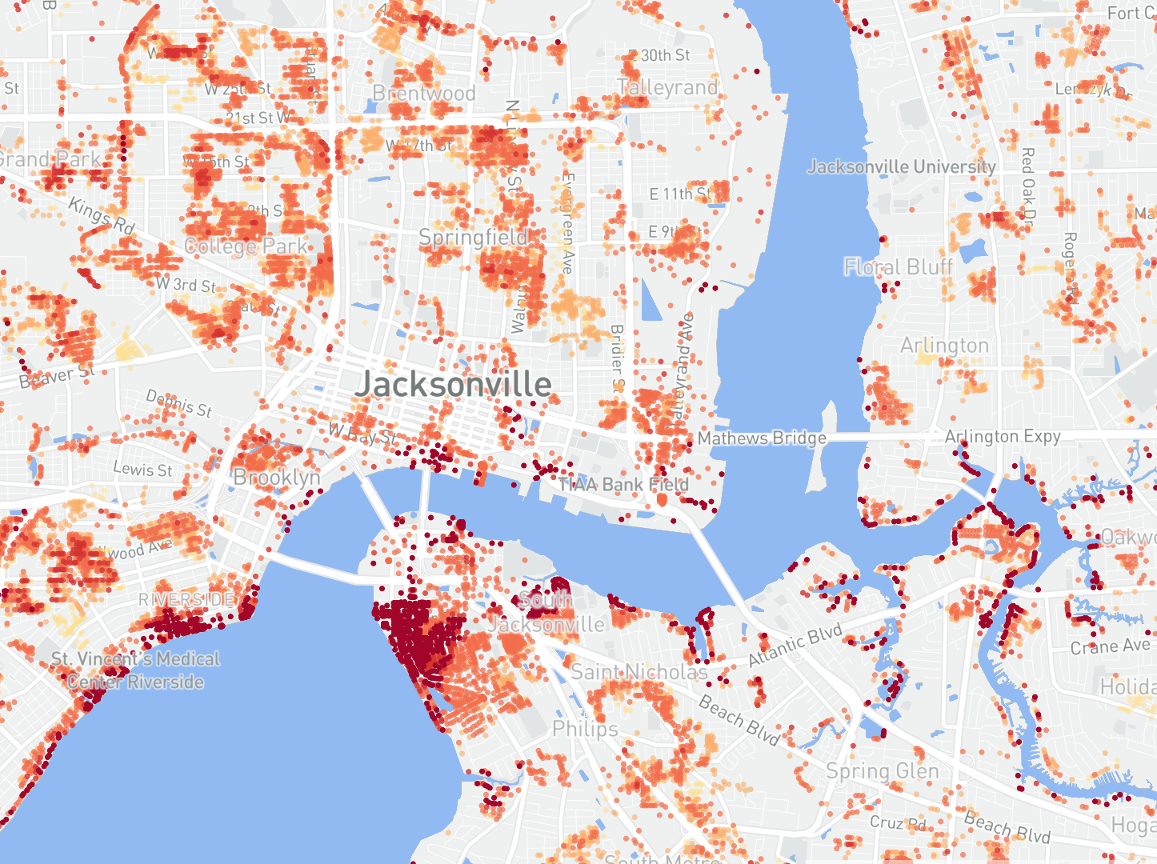

Slide 8
Number of Duval Parcels at Risk of Flooding
GIS Analysis: FEMA Floodplains
# Parcels at risk: 33,239 (9%)
2019 Total Duval Parcels: 372,511
Definition of Risk: FEMA 1% annual or 0.2% annual floodplain intersects with center of parcel
Methodology: Probabilistic flood model for Riverine and Tidal Flooding; Does not Incorporate SLR; Negotiated with local partners
First St. Foundation Analysis
# Parcels at risk: 48,408 (13%)
2019 Total Duval Parcels: 372,511
Definition of Risk: Inundation of 1 cm or more to the building in the 1% or 0.2% annual risk.
Methodology: Probabilistic flood model for Rain, Riverine, Tidal, Storm Surge; Incorporates SLR; Privately produced and not negotiated

Slide 9
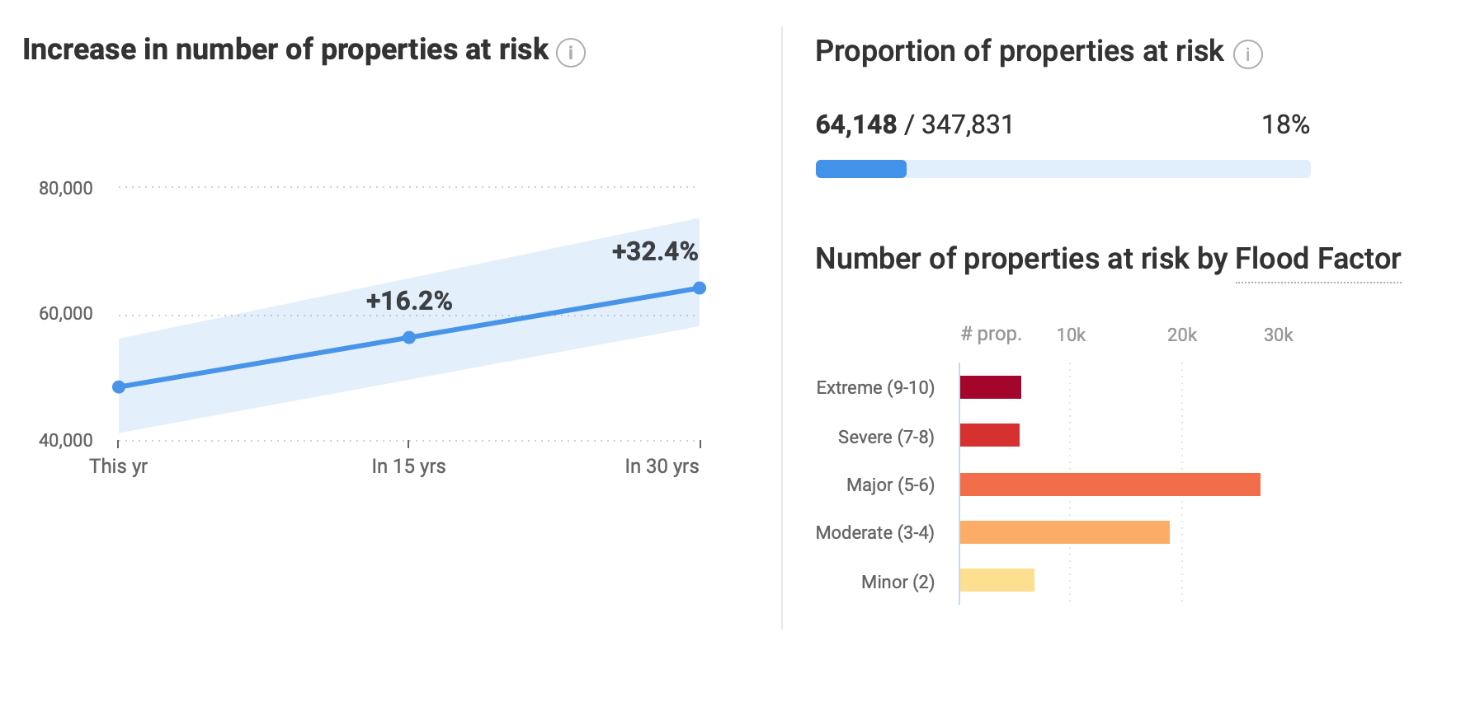
First Street Foundation Projected Increase
2035
# Parcels: 56,261 % of Total: 15% Projected Tax Val: $11,721,124,262
2050
# Parcels: 64,148 % of Total: 18% Projected Tax Val: $13,356,917,742

